Slide 1
Spatial Statistics in the Context of EDXS Maps
Charles Evans
May 2025

Slide 2
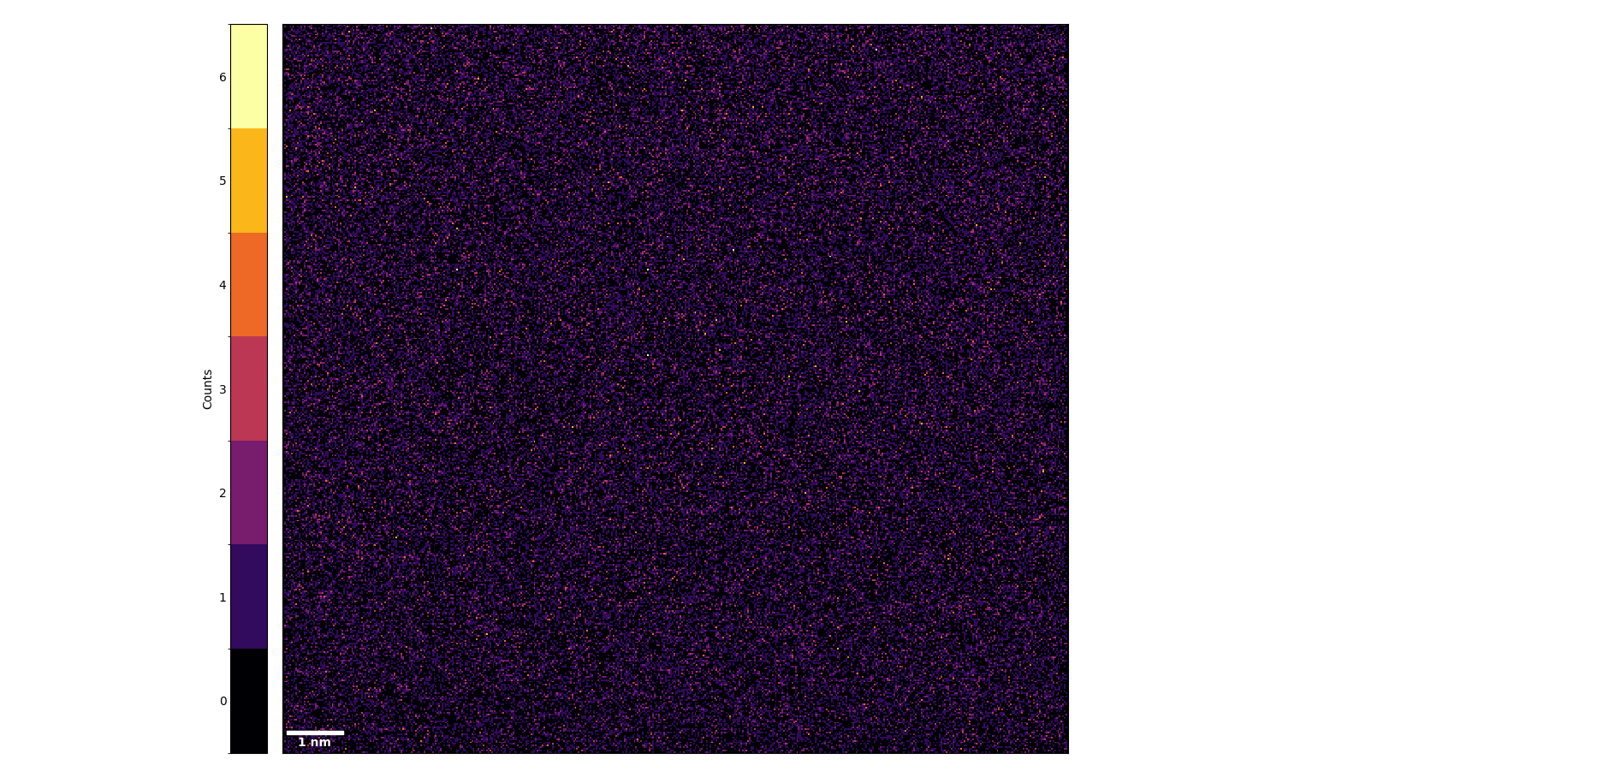

Motivation: Spatial Correlation in EDXS Maps
Does this EDXS map show any statistically significant spatial correlation?
Sc
It looks fairly “random,” but how do we know for sure?
For that matter, what exactly do we mean by “random” here?
How does our answer to this question depend on length scale?
How can we construct a formal hypothesis test for this question?

Slide 3
A Note about Spatial Data Analysis
Analyzing spatial data – even using formal statistical methods – is not a rote mechanical process: each dataset should be treated as unique, and the meaning of each analysis should be carefully considered.
Consider these two event datasets:
Both of these datasets exhibit overdispersion – the variance is higher than would be expected at “random” – however the form of overdispersion is very different, and likely arises from a different physical mechanism (which may be related to the elemental distribution in the sample, but may also be related to, e.g., thickness or orientation in the microscope).

Slide 4
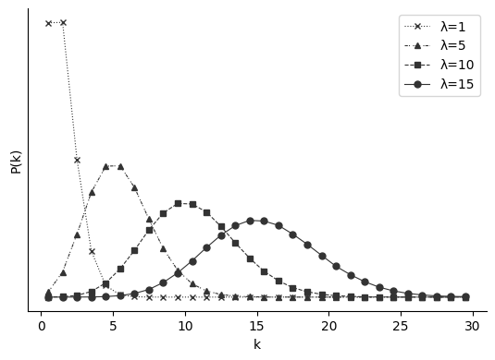
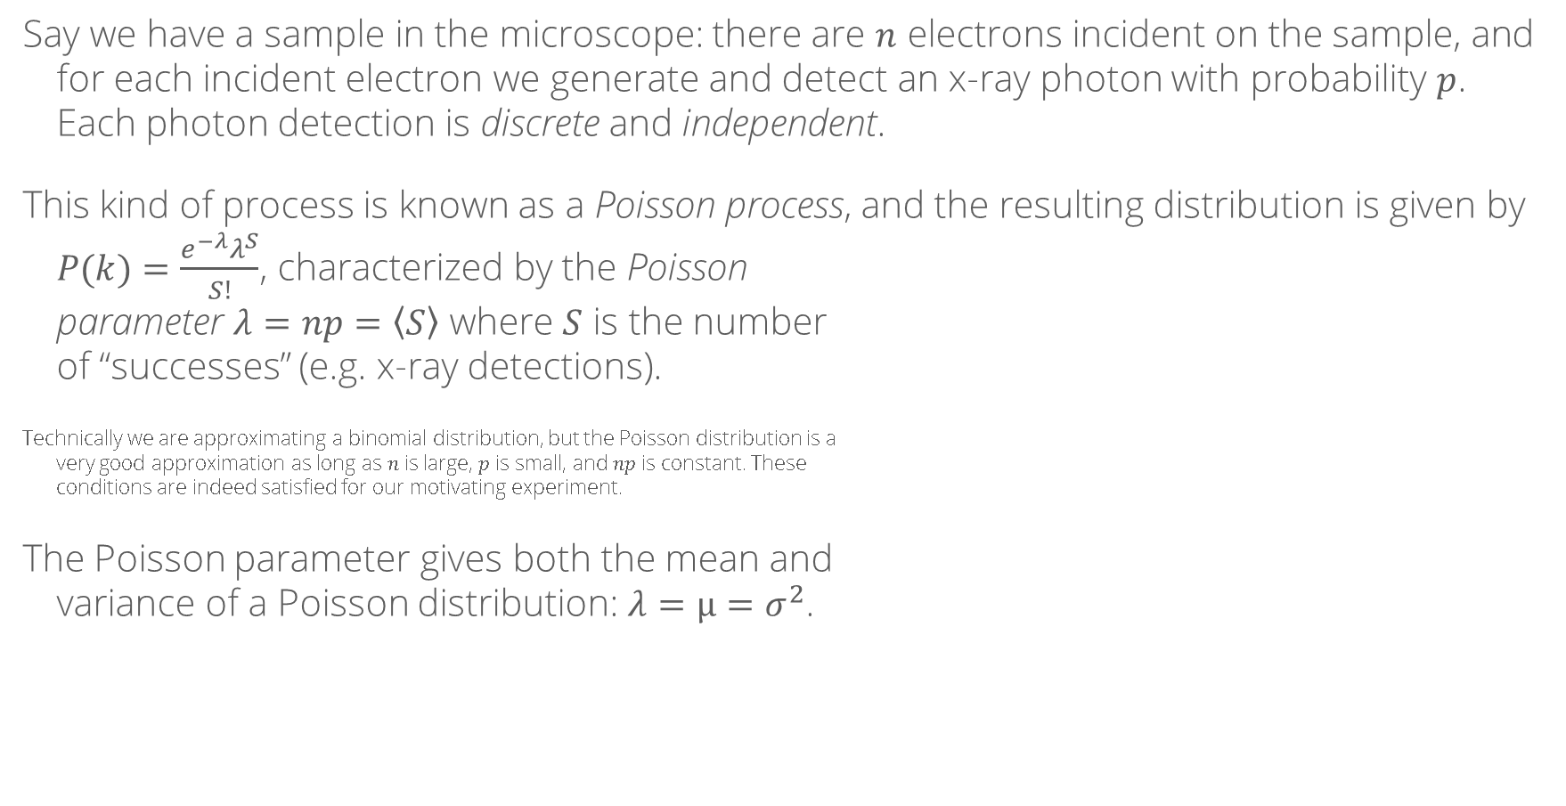
Statistical Properties of X-Ray Detection
Say we have a sample in the microscope: there are $n$ electrons incident on the sample, and for each incident electron we generate and detect an x-ray photon with probability $p$. Each photon detection is discrete and independent.
This kind of process is known as a Poisson process, and the resulting distribution is given by $P(k)=\frac{e^{−λ}λ^{S}}{S!}$, characterized by the Poisson parameter $λ=np=\left\langle S\right\rangle$ where $S$ is the number of “successes” (e.g. x-ray detections).
Technically we are approximating a binomial distribution, but the Poisson distribution is a very good approximation as long as $n$ is large, $p$ is small, and $np$ is constant. These conditions are indeed satisfied for our motivating experiment.
The Poisson parameter gives both the mean and variance of a Poisson distribution: $λ=μ=σ^{2}$.
“The role of Poisson’s binomial distribution in the analysis of TEM images,” Tejada & den Dekker, Ultramicroscopy 111(11), 2011, 10.1016/j.ultramic.2011.08.010
“The connection between the Poisson and binomial distributions,” Emory Oxford College Dept. of Mathematics & Computer Science, https://math.oxford.emory.edu/site/math117/connectingPoissonAndBinomial/

Slide 5
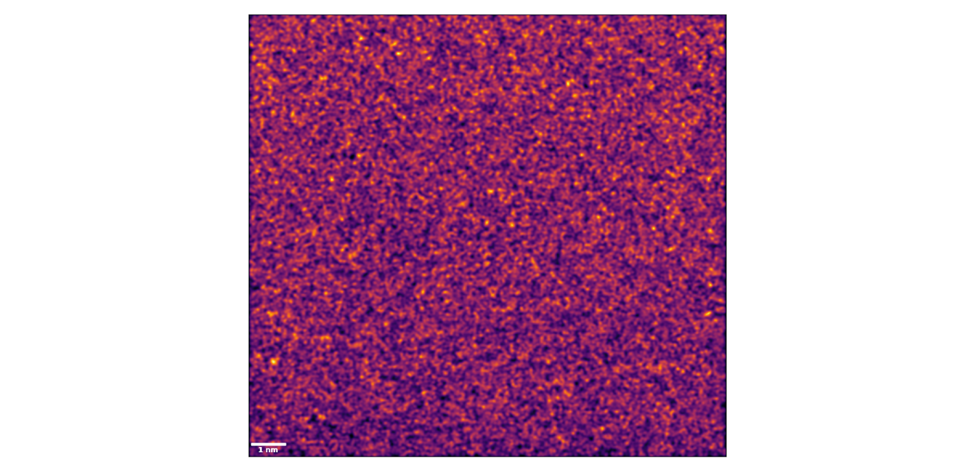
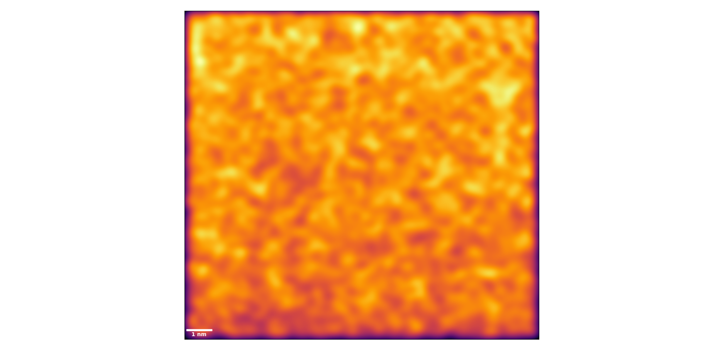
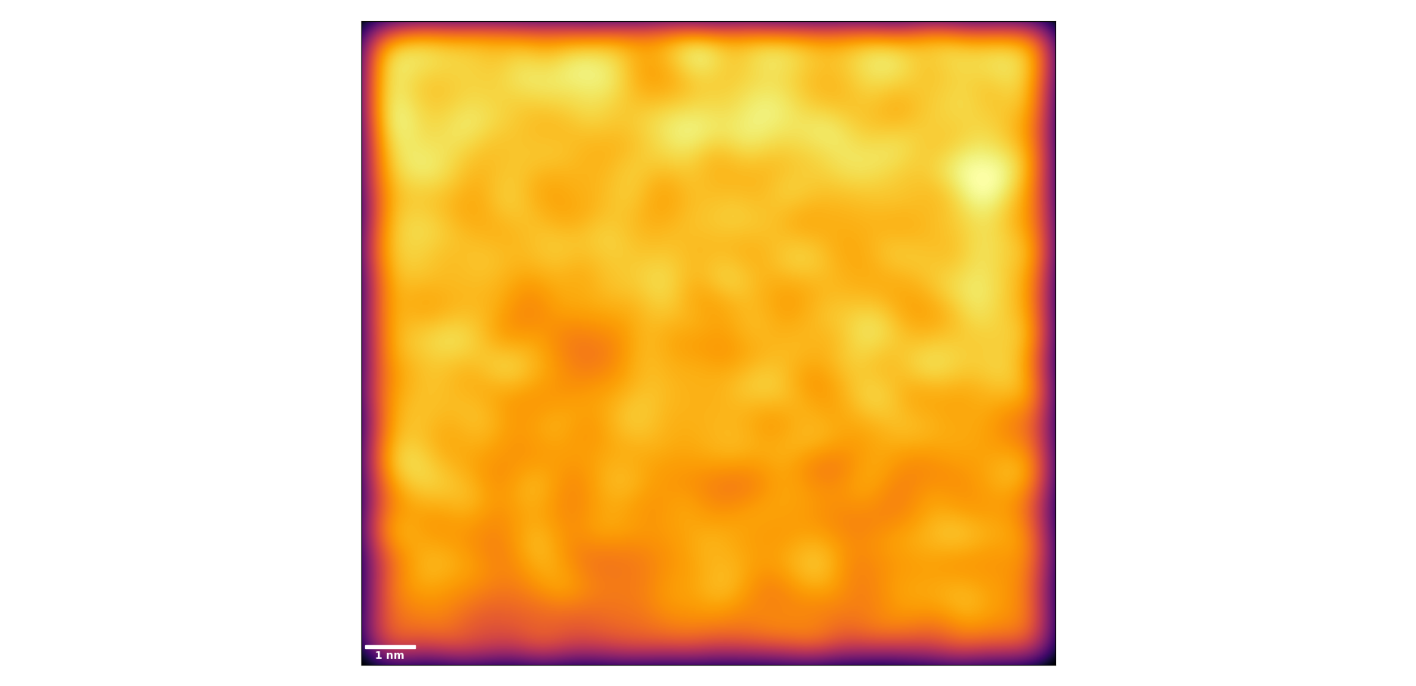
Exploratory Analysis: Gaussian KDE
One qualitative method we can use to look for potentially relevant length scales in our map is gaussian kernel density estimation (KDE), where a gaussian kernel with some bandwidth is rastered over the dataset to smooth out counts.
The choice of bandwidth will have a large effect on the observed result:
This is a good method for getting an overview of the structure of the data, but is not easily translated to formal hypothesis testing.
0.01
0.05
0.10

Slide 6
The Quadrat Counts Method
Given an EDXS map for some element, we can divide that map up into quadrats (equally-sized subregions, usually square) and get a count of the detections in each quadrat:
3330 | 3254 | 3248 | 3271 | 3206 | 3256
3186 | 3044 | 3130 | 3144 | 3178 | 3248
3093 | 2948 | 3089 | 3050 | 3095 | 3180
2988 | 2941 | 2997 | 3027 | 3071 | 3046
2991 | 2855 | 2909 | 2889 | 2821 | 2941
2662 | 2624 | 2671 | 2772 | 2677 | 2791
When performing this analysis, we must be aware of the scale of the quadrats, with respect to the scale of any expected clustering. If quadrats are too large, we will miss our signal. If they are too small, we may invalidate the statistical methods.
This is known as the modifiable areal unit problem (MAUP) and is ubiquitous in spatial statistics.
“Quadrat analysis of grid datsets,” Geospatial Analysis – A Comprehensive Guide, https://www.spatialanalysisonline.com/HTML/index.html?quadrat_analysis_of_grid_datas.htm
“Modifiable Areal Unit Problem,” Wong, The SAGE Handbook of Spatial Analysis, 2009, 10.1016/B978-008044910-4.00475-2
“The Modifiable Areal Unit Problem,” Openshaw, CATMOG 38, 1984, https://www.uio.no/studier/emner/sv/iss/SGO9010/openshaw1983.pdf

Slide 7
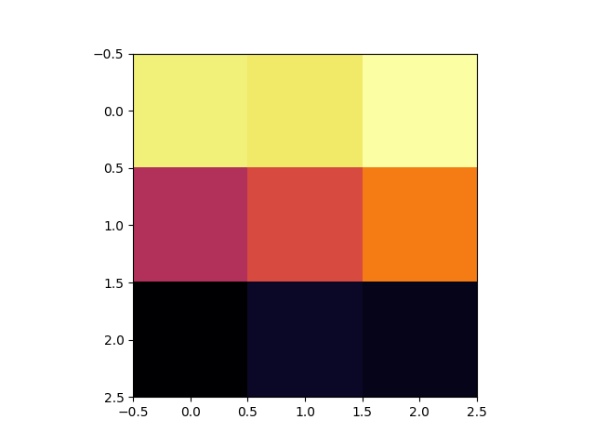
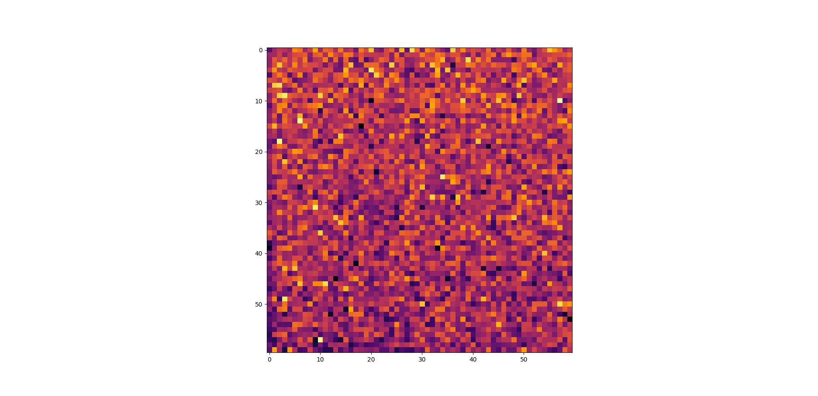
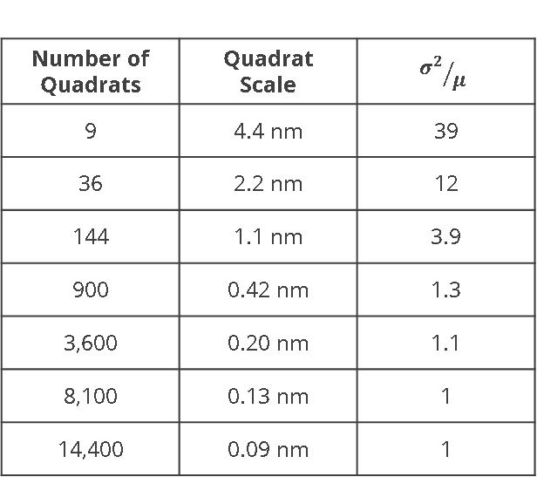
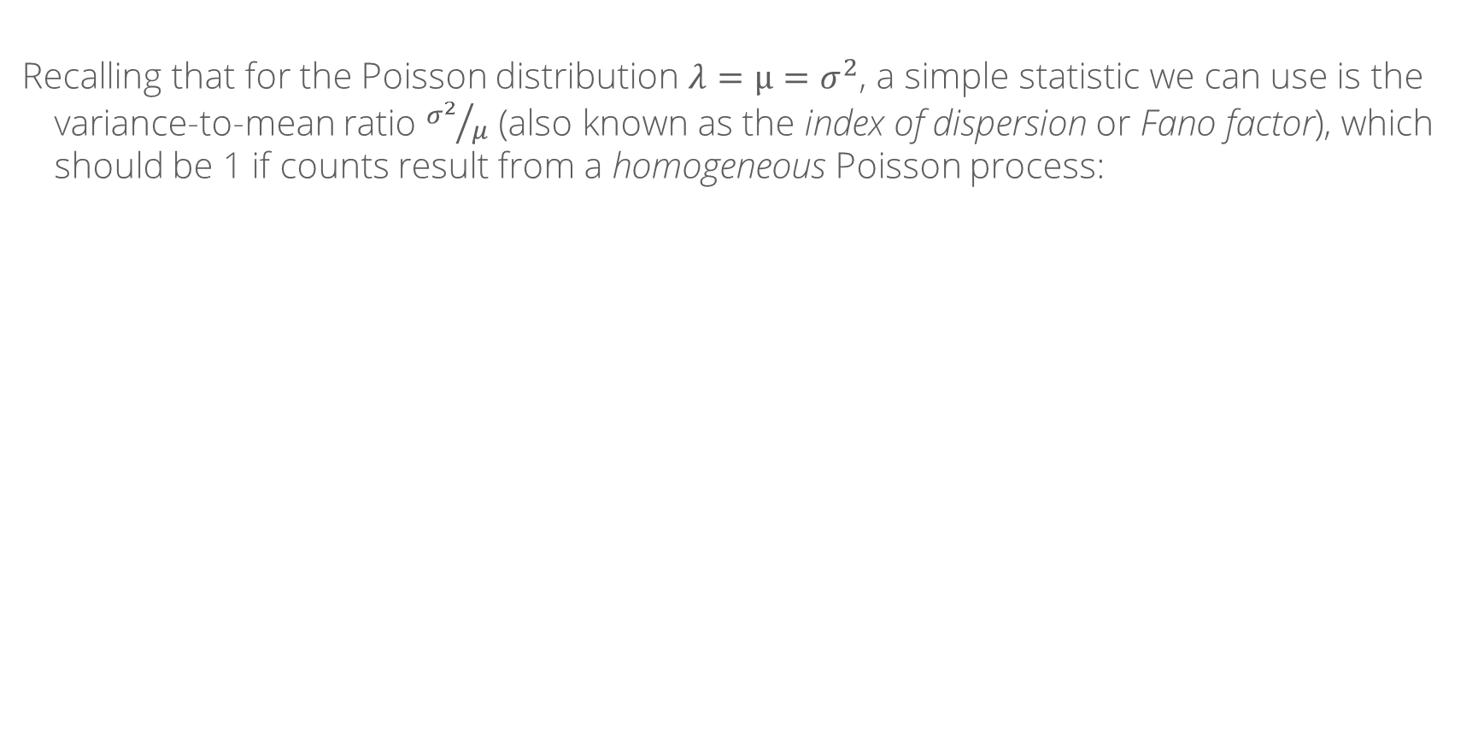
Quadrat Test Statistics: ${σ^{2}}/μ$
Recalling that for the Poisson distribution $λ=μ=σ^{2}$, a simple statistic we can use is the variance-to-mean ratio ${σ^{2}}/μ$ (also known as the index of dispersion or Fano factor), which should be 1 if counts result from a homogeneous Poisson process:
Number of Quadrats | Quadrat Scale | $${σ^{2}}/μ$$
9 | 4.4 nm | 39
36 | 2.2 nm | 12
144 | 1.1 nm | 3.9
900 | 0.42 nm | 1.3
3,600 | 0.20 nm | 1.1
8,100 | 0.13 nm | 1
14,400 | 0.09 nm | 1
The observed decreasing trend for our test dataset suggests that there is some large-scale inhomogeneity, but that at small scales the sample is homogeneous:
4.4 nm Quadrats
0.2 nm Quadrats
Make sure not to make the quadrats too small! Here I’ve used a minimum size of about 1Å – which is physically meaningful – but if data is sparse they might need to be larger to avoid having many empty quadrats.
“Point Pattern Analysis II,” Paez, “An Introduction to Spatial Data Analysis and Statistics: A Course in R,” ch. 11, 2021, https://paezha.github.io/spatialanalysis-r/point-patern-analysis-ii.html

Slide 8
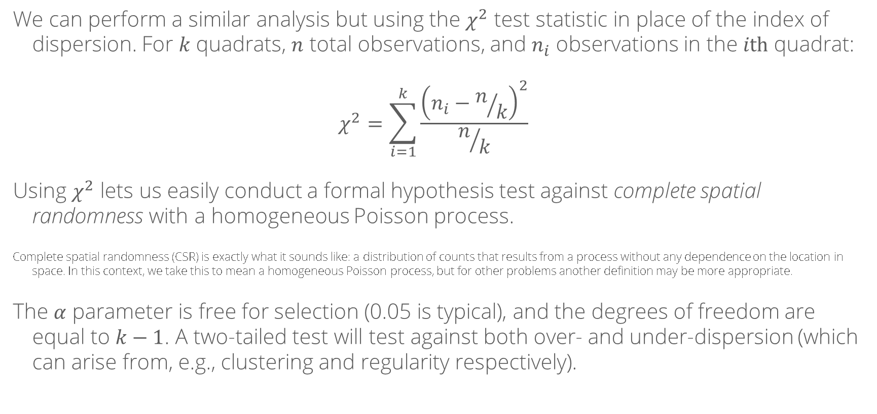
Quadrat Test Statistics: $χ^{2}$
We can perform a similar analysis but using the $χ^{2}$ test statistic in place of the index of dispersion. For $k$ quadrats, $n$ total observations, and $n_{i}$ observations in the $i\text{th}$ quadrat:
$$χ^{2}=\sum_{i=1}^{k}{\frac{{\left(n_{i}−n/k\right)}^{2}}{n/k}}$$
Using $χ^{2}$ lets us easily conduct a formal hypothesis test against complete spatial randomness with a homogeneous Poisson process.
Complete spatial randomness (CSR) is exactly what it sounds like: a distribution of counts that results from a process without any dependence on the location in space. In this context, we take this to mean a homogeneous Poisson process, but for other problems another definition may be more appropriate.
The $α$ parameter is free for selection (0.05 is typical), and the degrees of freedom are equal to $k−1$. A two-tailed test will test against both over- and under-dispersion (which can arise from, e.g., clustering and regularity respectively).
“Complete Spatial Randomness,” Morgana, “Spatial Statistics for Data Science: Theory and Practice with R,” ch. 20, n.d., https://www.paulamoraga.com/book-spatial/preface.html

Slide 9
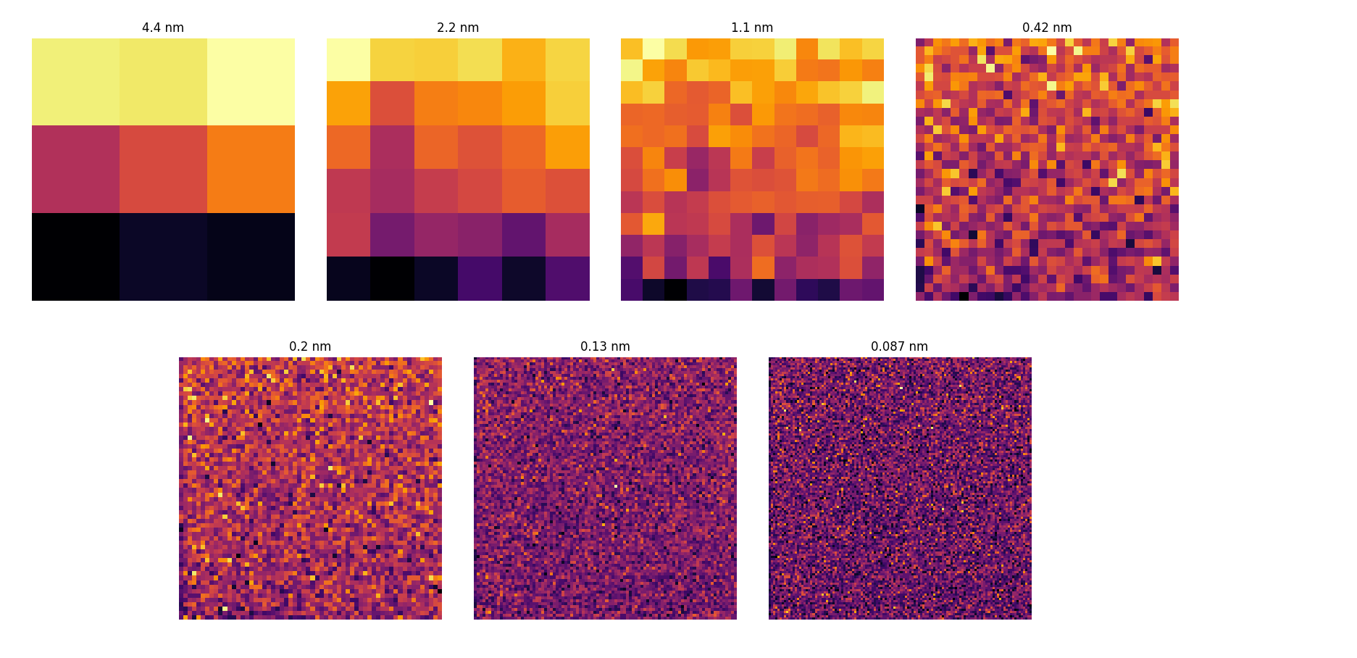
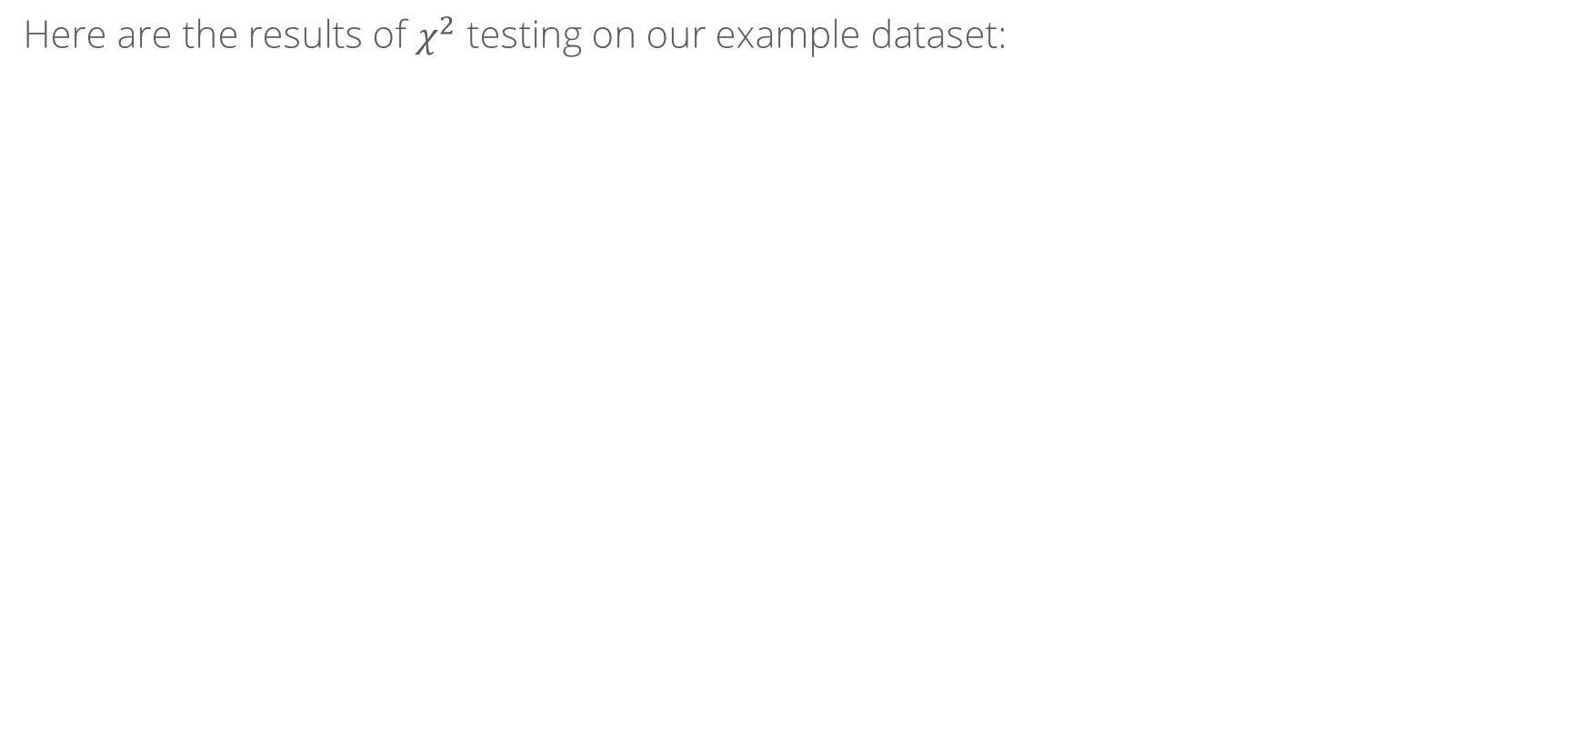
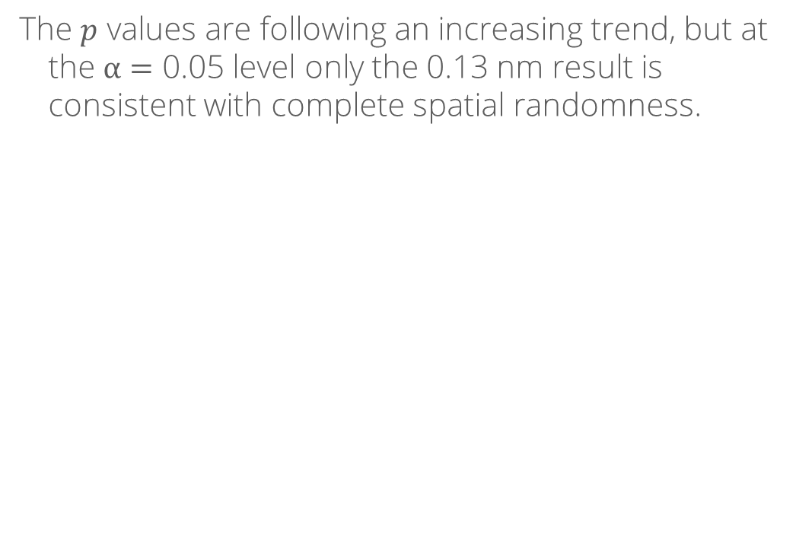
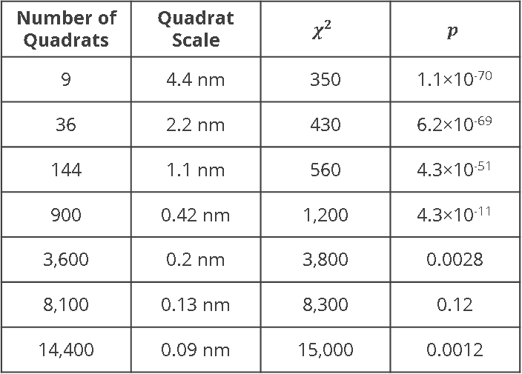
Quadrat Test Statistics: $χ^{2}$
Here are the results of $χ^{2}$ testing on our example dataset:
Number of Quadrats | Quadrat Scale | $$χ^{2}$$ | $$p$$
9 | 4.4 nm | 350 | 1.1×10⁻⁷⁰
36 | 2.2 nm | 430 | 6.2×10⁻⁶⁹
144 | 1.1 nm | 560 | 4.3×10⁻⁵¹
900 | 0.42 nm | 1,200 | 4.3×10⁻¹¹
3,600 | 0.2 nm | 3,800 | 0.0028
8,100 | 0.13 nm | 8,300 | 0.12
14,400 | 0.09 nm | 15,000 | 0.0012
The $p$ values are following an increasing trend, but at the $α=$ 0.05 level only the 0.13 nm result is consistent with complete spatial randomness.
Based on our observations, this is likely because our process is inhomogeneous at large scales: we have more counts near the top of the imaged region than the bottom.

Slide 10
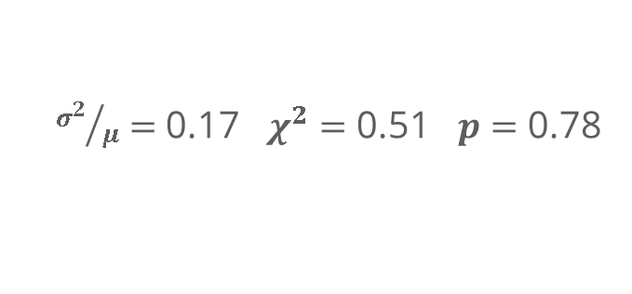
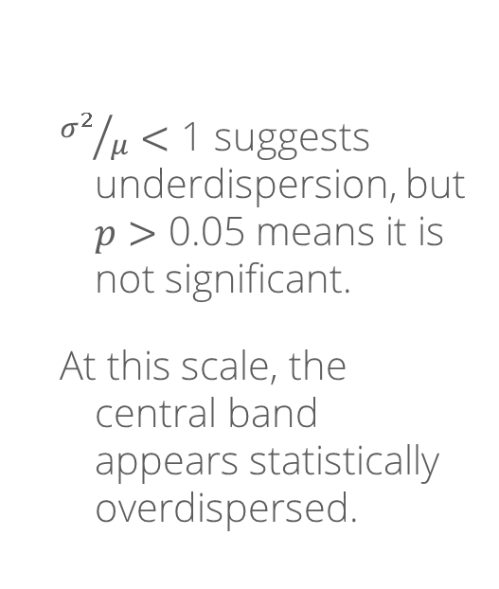
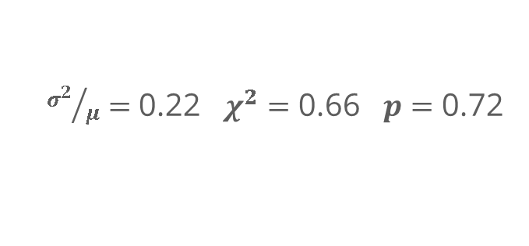
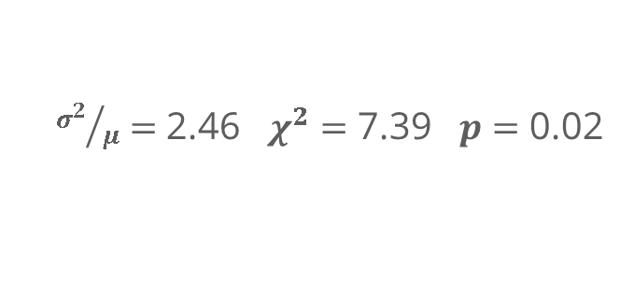
Testing within Subregions
Because of the large-scale inhomogeneity in our sample, our ability to reliably confirm or refute the presence of small-scale clustering is hindered. One way around this is to analyze subregions separately. Since the large-scale gradient runs top-to-bottom, we can perform our tests in horizontal bands:
As always, the scale of the bands will affect the scale of clustering we might detect.
${σ^{2}}/μ<$ 1 suggests underdispersion, but $p>$ 0.05 means it is not significant.
At this scale, the central band appears statistically overdispersed.
${σ^{2}}/μ=$ 0.17 $χ^{2}=$ 0.51 $p=$ 0.78
${σ^{2}}/μ=$ 2.46 $χ^{2}=$ 7.39 $p=$ 0.02
${σ^{2}}/μ=$ 0.22 $χ^{2}=$ 0.66 $p=$ 0.72

Slide 11
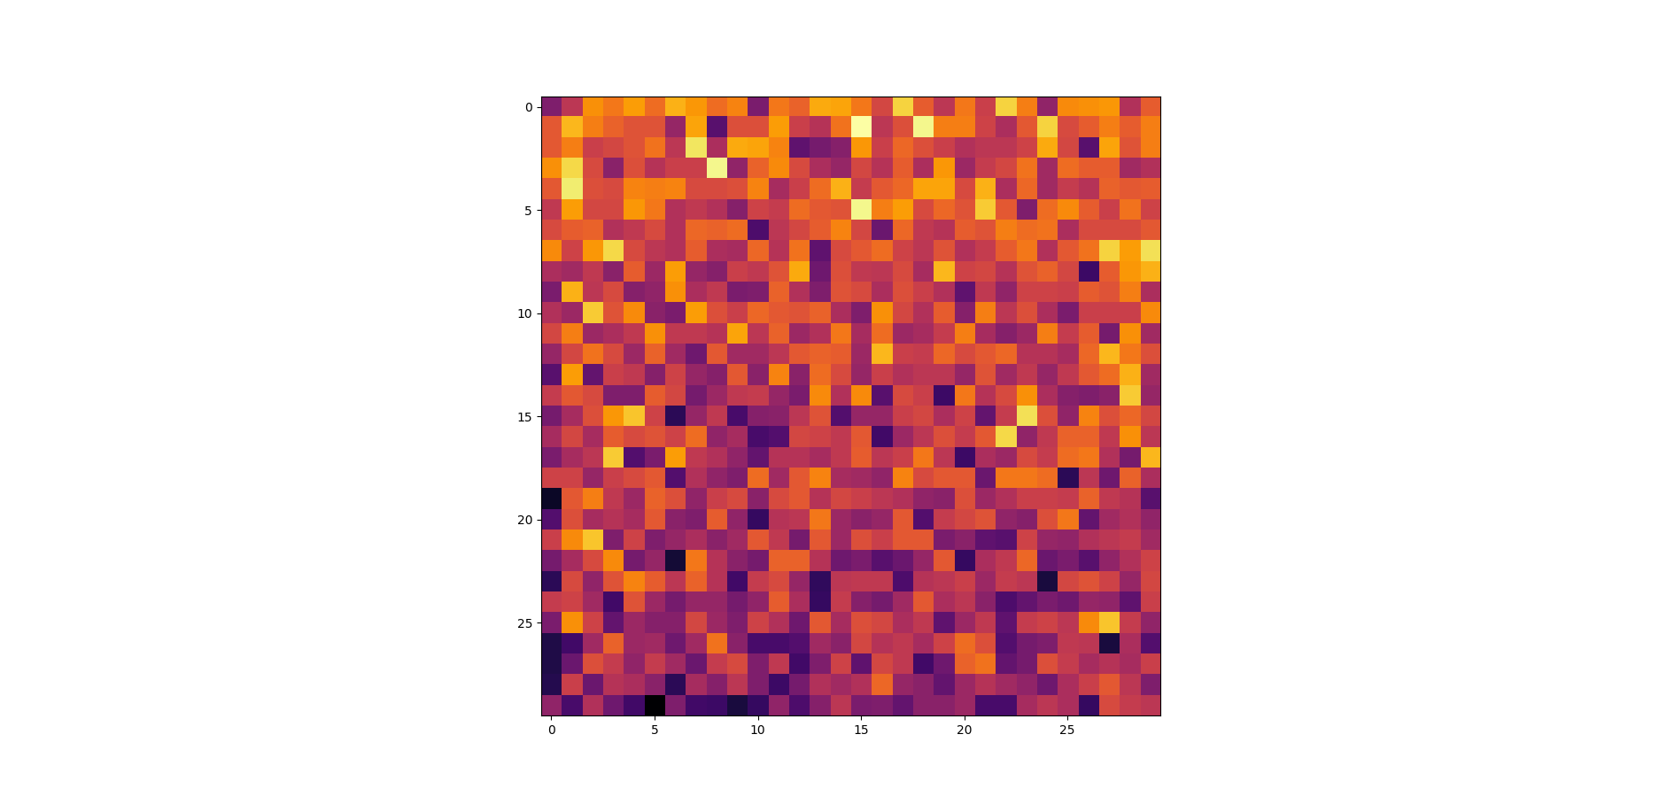
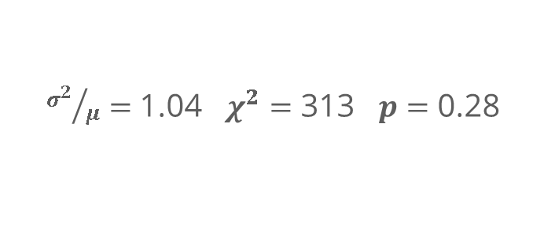
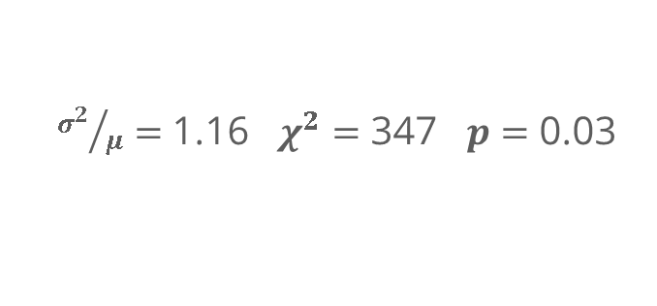
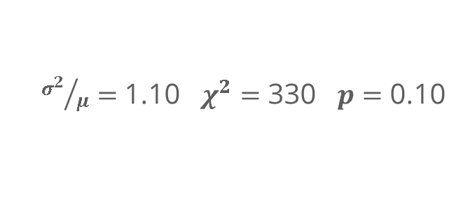
Testing with Subregions
Using a 0.42 nm sampling with the same subregions, we now find the central region is not overdispersed, but the bottom region is.
So far, this analysis doesn’t suggest any nano-scale clustering of Sc in these thin films of (Al,Sc)N. However, it has established a need to treat the sample in smaller areal units than the whole image, due to macro-scale inhomogeneity in the signal.
Through the following slides we will test for clustering using a local technique.
${σ^{2}}/μ=$ 1.04 $χ^{2}=$ 313 $p=$ 0.28
${σ^{2}}/μ=$ 1.10 $χ^{2}=$ 330 $p=$ 0.10
${σ^{2}}/μ=$ 1.16 $χ^{2}=$ 347 $p=$ 0.03

Slide 12
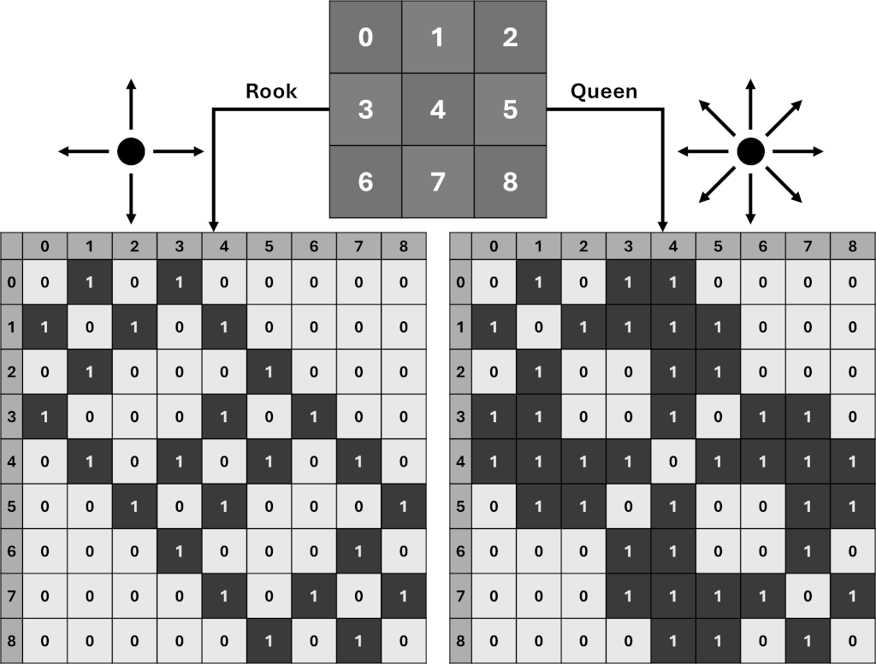
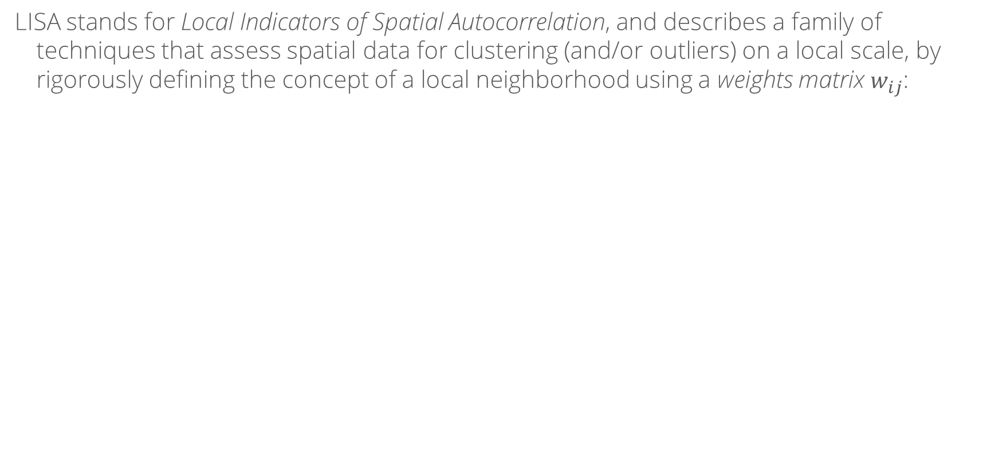
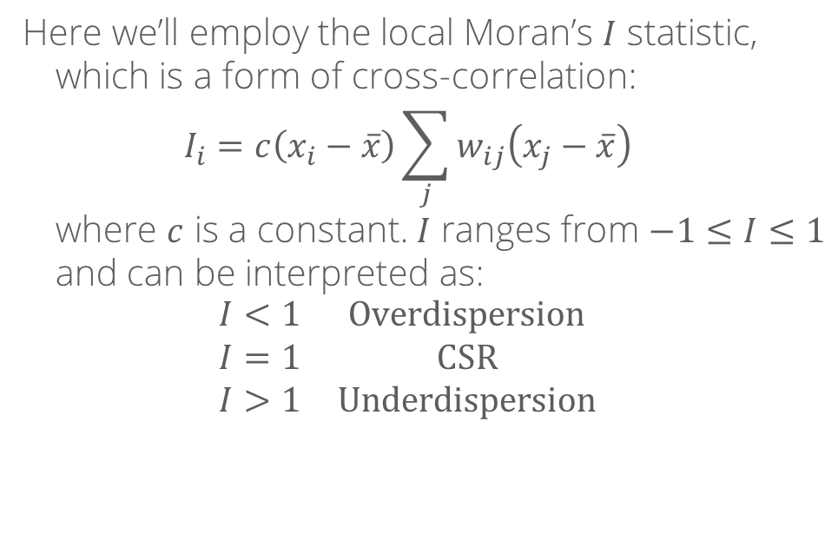
LISA: Moran’s $I$ Statistic
LISA stands for Local Indicators of Spatial Autocorrelation, and describes a family of techniques that assess spatial data for clustering (and/or outliers) on a local scale, by rigorously defining the concept of a local neighborhood using a weights matrix $w_{ij}$:
Here we’ll employ the local Moran’s $I$ statistic, which is a form of cross-correlation: $$I_{i}=c\left(x_{i}−\overline{x}\right)\sum_{j}{w_{ij}\left(x_{j}−\overline{x}\right)}$$ where $c$ is a constant. $I$ ranges from $−1≤I≤1$ and can be interpreted as: $$\begin{matrix}I<1 & \text{Overdispersion} \\ I=1 & \text{CSR} \\ I>1 & \text{Underdispersion}\end{matrix}$$
“Local Indicators of Spatial Autocorrelation—LISA,” Anselin, Geographical Analysis 27(2), 1995, 10.1111/j.1538-4632.1995.tb00338.x
“Local Spatial Autocorrelation (1): LISA and Local Moran”, Anselin, “GeoDa: An Introduction to Spatial Data Science,” 2020, https://geodacenter.github.io/workbook/6a_local_auto/lab6a.html

Slide 13
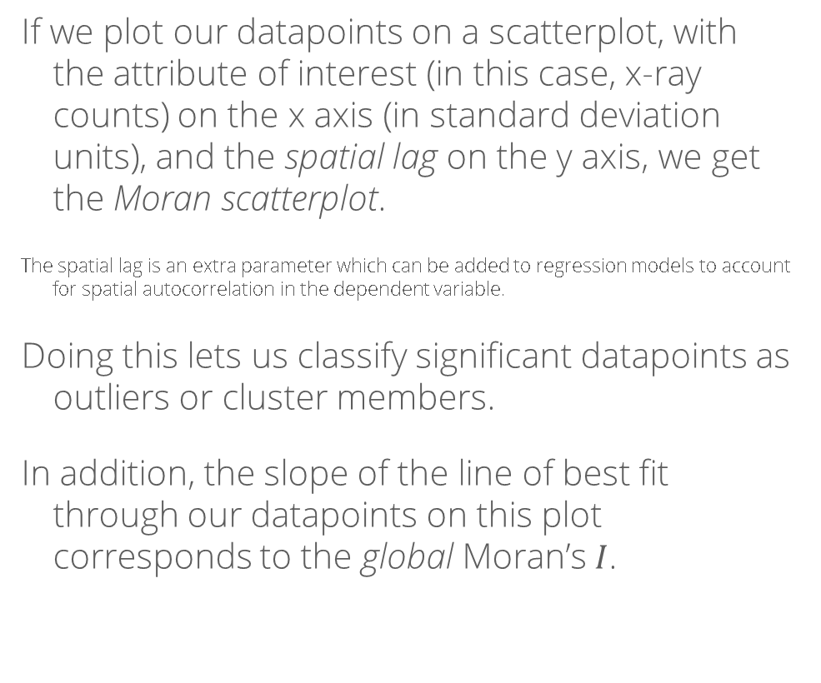
The Moran Scatter Plot
If we plot our datapoints on a scatterplot, with the attribute of interest (in this case, x-ray counts) on the x axis (in standard deviation units), and the spatial lag on the y axis, we get the Moran scatterplot.
The spatial lag is an extra parameter which can be added to regression models to account for spatial autocorrelation in the dependent variable.
Doing this lets us classify significant datapoints as outliers or cluster members.
In addition, the slope of the line of best fit through our datapoints on this plot corresponds to the global Moran’s $I$.
Quadrant 2 Low-High
(Low-Valued Outliers)
Quadrant 1 High-High
(High-Valued Clusters)
Spatial Lag
Quadrant 3 Low-Low
(Low-Valued Clusters)
Quadrant 4 High-Low
(High-Valued Outliers)
Attribute (Standard Deviation Units)
“Spatial Regression Analysis: Advanced Data Analytics,” Gentry, n.d., https://chrismgentry.github.io/Spatial-Regression/
“Global Spatial Autocorrelation (1): Visualizing Spatial Autocorrelation,” Anselin, “GeoDa: An Introduction to Spatial Data Analysis,” 2020, https://geodacenter.github.io/workbook/5a_global_auto/lab5a.html

Slide 14
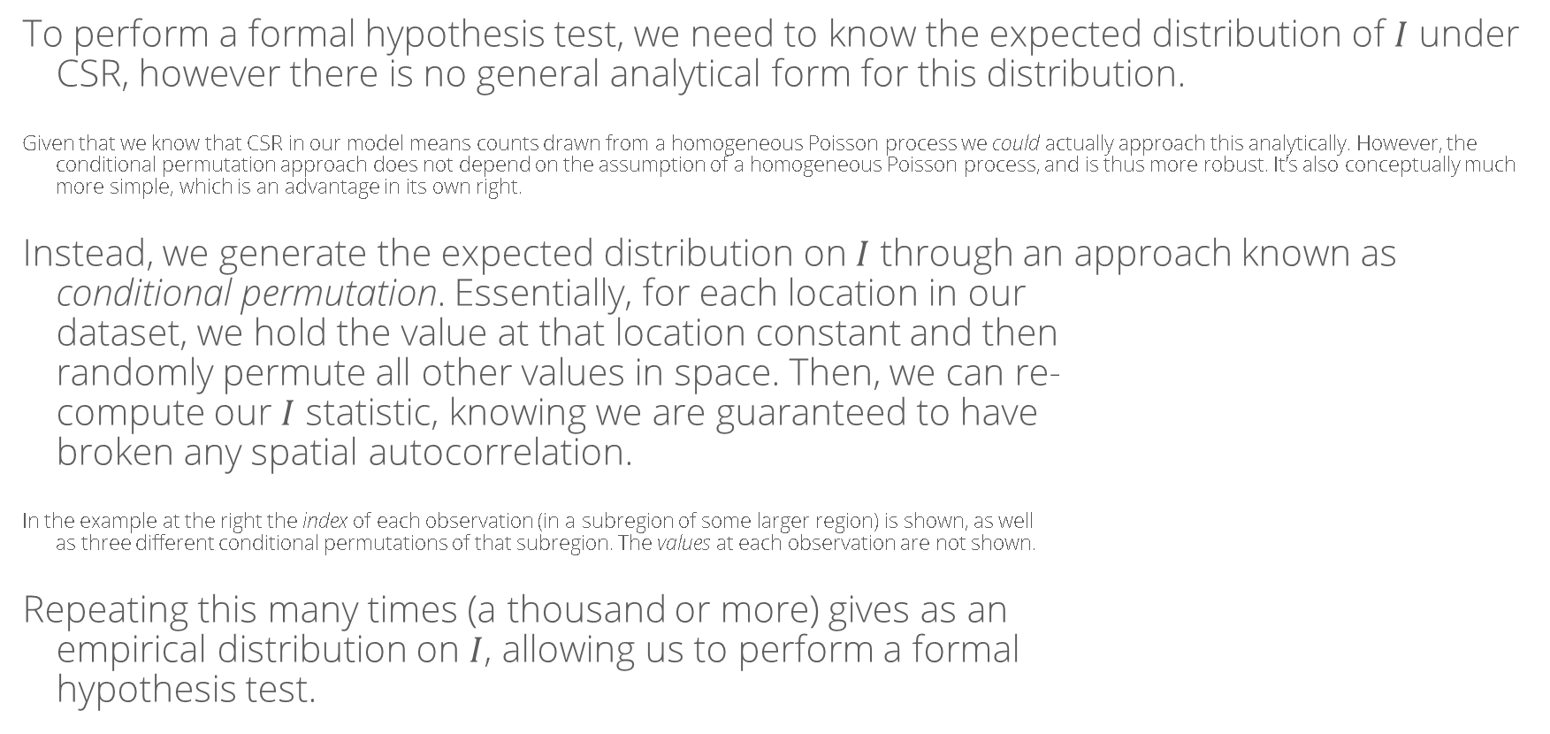
Hypothesis Testing: Conditional Permutation
To perform a formal hypothesis test, we need to know the expected distribution of $I$ under CSR, however there is no general analytical form for this distribution.
Given that we know that CSR in our model means counts drawn from a homogeneous Poisson process we could actually approach this analytically. However, the conditional permutation approach does not depend on the assumption of a homogeneous Poisson process, and is thus more robust. It’s also conceptually much more simple, which is an advantage in its own right.
Instead, we generate the expected distribution on $I$ through an approach known as conditional permutation. Essentially, for each location in our dataset, we hold the value at that location constant and then randomly permute all other values in space. Then, we can re- compute our $I$ statistic, knowing we are guaranteed to have broken any spatial autocorrelation.
In the example at the right the index of each observation (in a subregion of some larger region) is shown, as well as three different conditional permutations of that subregion. The values at each observation are not shown.
Repeating this many times (a thousand or more) gives as an empirical distribution on $I$, allowing us to perform a formal hypothesis test.
000 | 001 | 002
003 | 004 | 005
006 | 007 | 008
862 | 848 | 567
127 | 004 | 495
009 | 220 | 033
297 | 977 | 800
317 | 004 | 953
946 | 513 | 680
028 | 287 | 663
360 | 004 | 519
432 | 825 | 733
“The exact distribution of Moran’s $I$,” Tiefelsdorf & Boots, Environment and Planning A 27, 1995, 10.1068/a270985

Slide 15
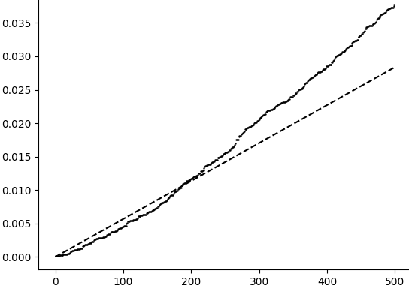
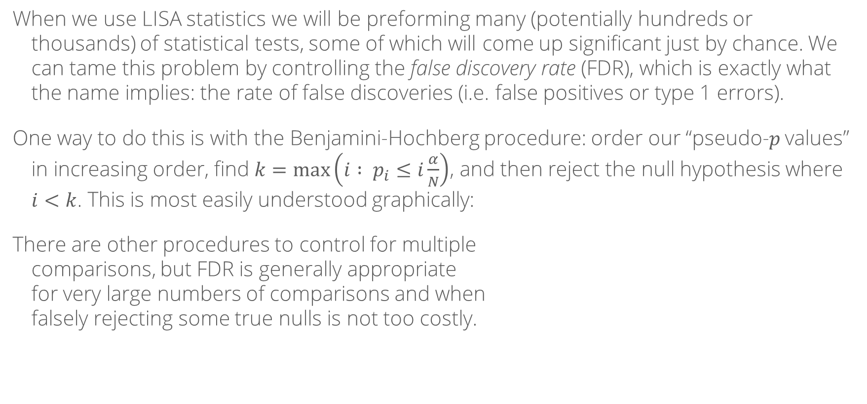
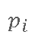
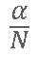
The Benjamini-Hochberg Procedure
When we use LISA statistics we will be preforming many (potentially hundreds or thousands) of statistical tests, some of which will come up significant just by chance. We can tame this problem by controlling the false discovery rate (FDR), which is exactly what the name implies: the rate of false discoveries (i.e. false positives or type 1 errors).
One way to do this is with the Benjamini-Hochberg procedure: order our “pseudo-$p$ values” in increasing order, find $k=\text{max}\left(i : p_{i}≤i\frac{α}{N}\right)$, and then reject the null hypothesis where $i<k$. This is most easily understood graphically:
There are other procedures to control for multiple comparisons, but FDR is generally appropriate for very large numbers of comparisons and when falsely rejecting some true nulls is not too costly.
Reject Null
Don’t Reject Null
$$\frac{α}{N}$$
$$p_{i}$$
“Controlling the False Discovery Rate: A Practical and Powerful Approach to Multiple Testing,” Benjamini & Hochberg, Journal of the Royal Statistical Society: Series B, 1995, 10.1111/j.2517-6161.1995.tb02031.x
“Multiple Comparisons,” McDonald, “Biological Statistics,” ch. 6.1, 2024, https://stats.libretexts.org/Bookshelves/Applied_Statistics/Biological_Statistics_(McDonald)/06%3A_Multiple_Tests/6.01%3A_Multiple_Comparisons
$$i$$

Slide 16
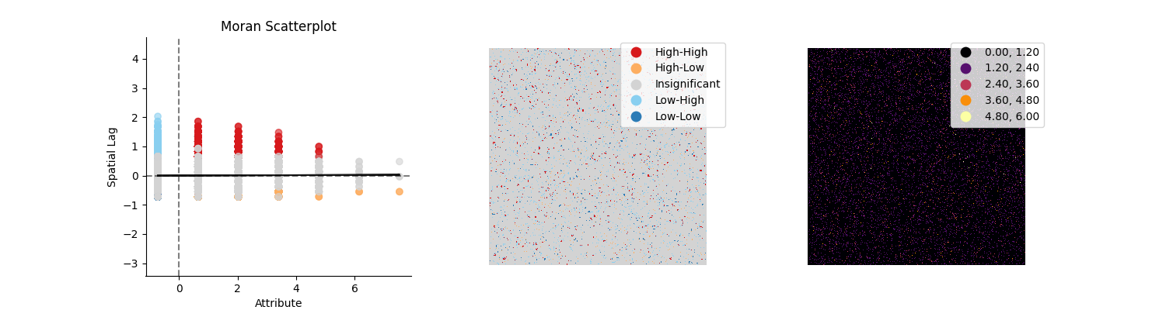
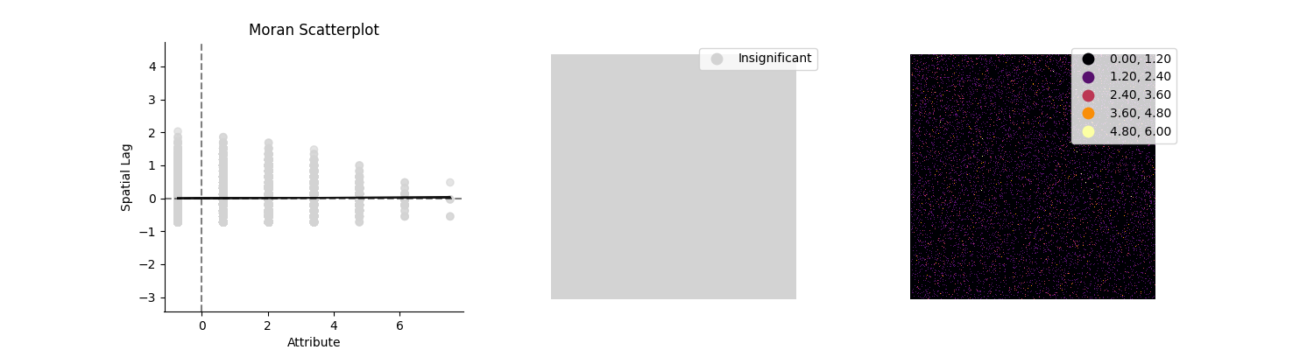

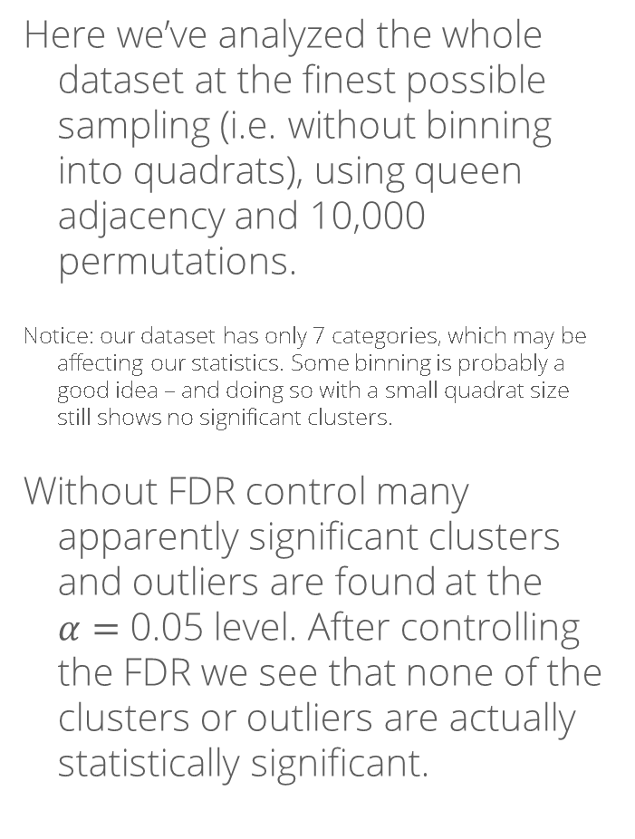


Results of the Local Moran Analysis
Here we’ve analyzed the whole dataset at the finest possible sampling (i.e. without binning into quadrats), using queen adjacency and 10,000 permutations.
Notice: our dataset has only 7 categories, which may be affecting our statistics. Some binning is probably a good idea – and doing so with a small quadrat size still shows no significant clusters.
Without FDR control many apparently significant clusters and outliers are found at the $α=$ 0.05 level. After controlling the FDR we see that none of the clusters or outliers are actually statistically significant.
$α=$ 0.05 No FDR Control
Spatial Lag
$α=$ 0.05 Benjamini-Hochberg
Spatial Lag
Counts ($σ$ Units)

Slide 17
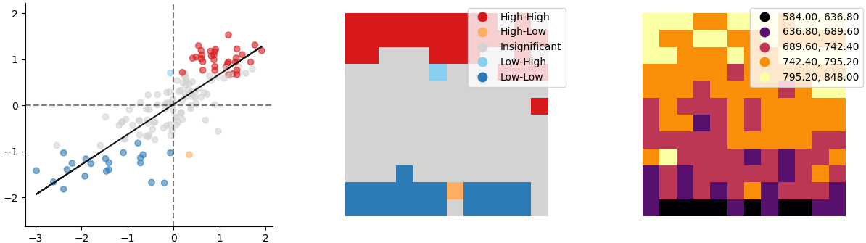

Results of the Local Moran Analysis
Of course, if we instead perform the same analysis on our binned quadrats (in this case with a scale of 1.1 nm), we again pick up the large-scale inhomogeneity which we discovered using the quadrat count methods:
This method lets us immediately visualize the overall shape of the inhomogeneity. In this case we already knew that we had a vertical gradient in counts, but this would be helpful if there were some less simple shape to the inhomogeneity.
Spatial Lag
Counts ($σ$ Units)

Slide 18
Conclusions (for this sample & region)
We can conclude the following:
There is no statistically-significant nano-scale segregation of Sc in this sample of (Al,Sc)N on GaN.
There is some large-scale inhomogeneity in the field of view, with fewer Sc counts detected near the substrate than near the thin edge.
Further analysis on different TEM samples or regions may allow us to learn the cause of the large-scale inhomogeneity.

Slide 19
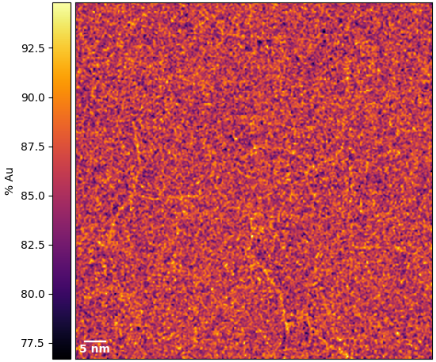
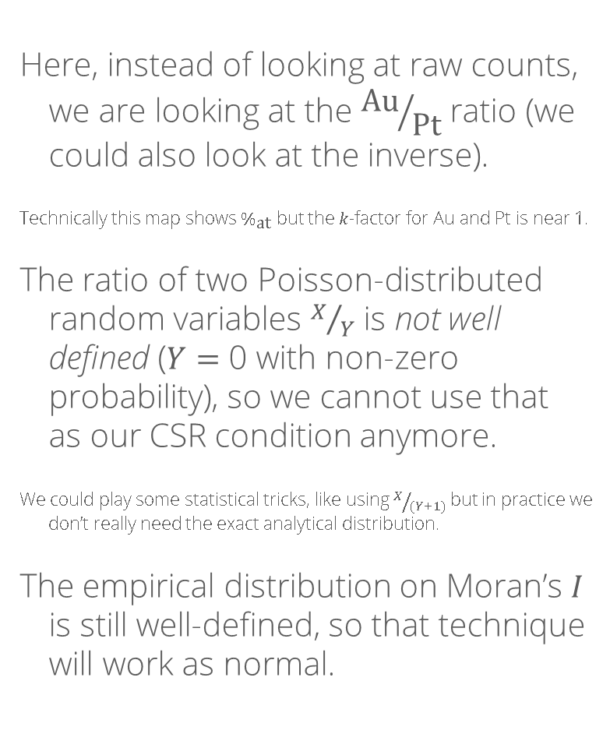
Another example: grain boundary segregation
Here, instead of looking at raw counts, we are looking at the ${\text{Au}}/{\text{Pt}}$ ratio (we could also look at the inverse).
Technically this map shows $\%_{\text{at}}$ but the $k$-factor for Au and Pt is near 1.
The ratio of two Poisson-distributed random variables $X/Y$ is not well defined ($Y=$ 0 with non-zero probability), so we cannot use that as our CSR condition anymore.
We could play some statistical tricks, like using $X/{(Y+1)}$ but in practice we don’t really need the exact analytical distribution.
The empirical distribution on Moran’s $I$ is still well-defined, so that technique will work as normal.

Slide 20
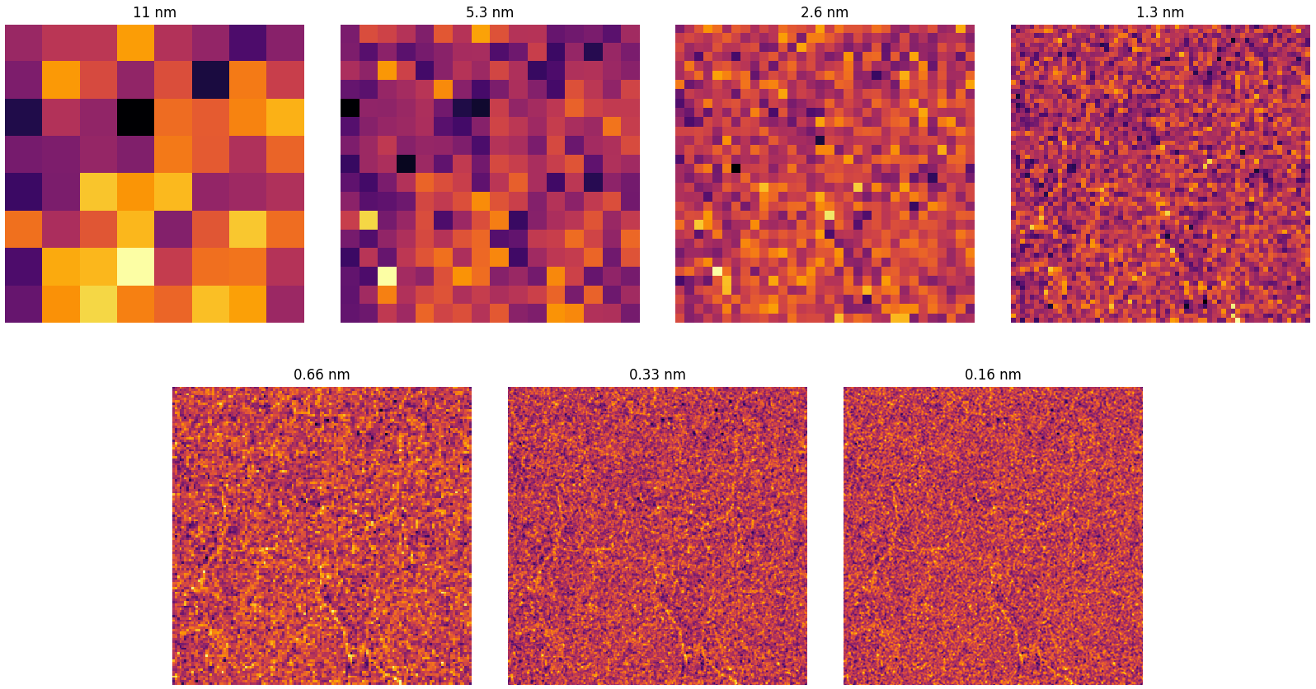
Overview: Quadrats
The smallest sampling here (0.16 nm) is at the pixel size resolution.
We could also look at the gaussian KDE, but there are enough counts in this dataset that convolving it doesn’t serve much purpose.

Slide 21
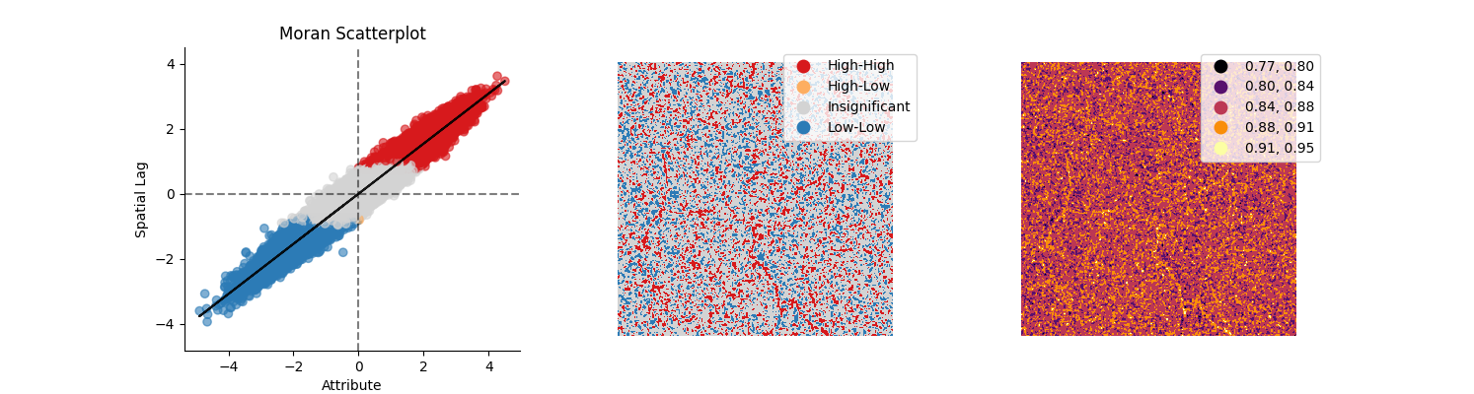
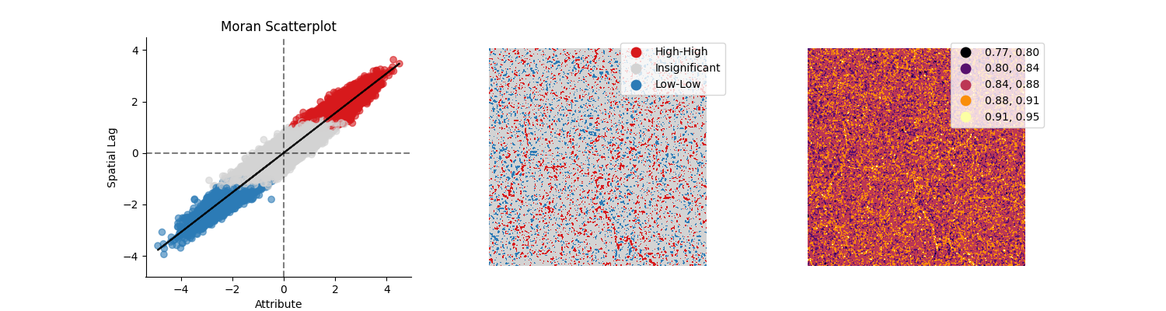

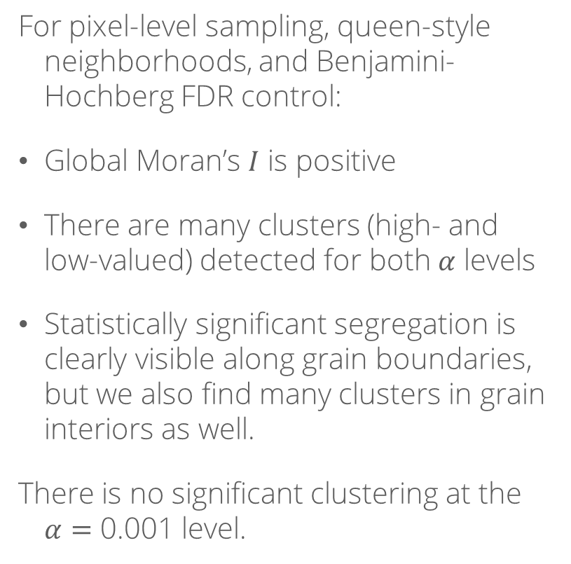

Moran’s $I$ for two $α$ levels
For pixel-level sampling, queen-style neighborhoods, and Benjamini-Hochberg FDR control:
Global Moran’s $I$ is positive
There are many clusters (high- and low-valued) detected for both $α$ levels
Statistically significant segregation is clearly visible along grain boundaries, but we also find many clusters in grain interiors as well.
There is no significant clustering at the $α=$ 0.001 level.
$α=$ 0.05
$α=$ 0.01

Slide 22
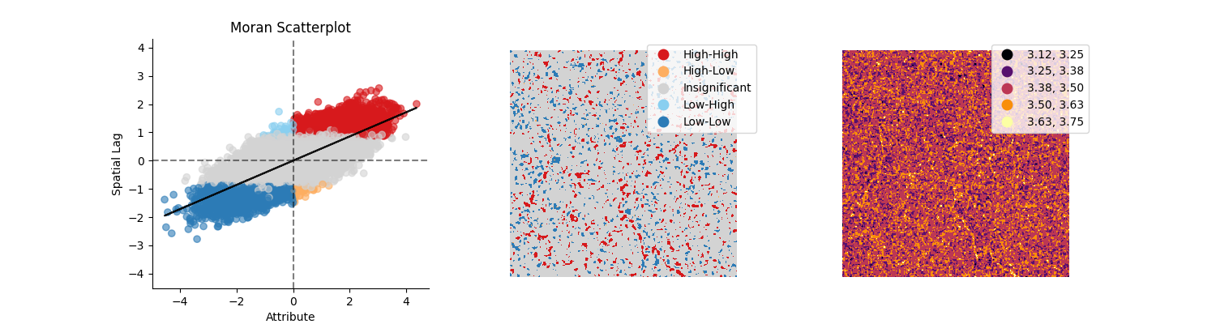
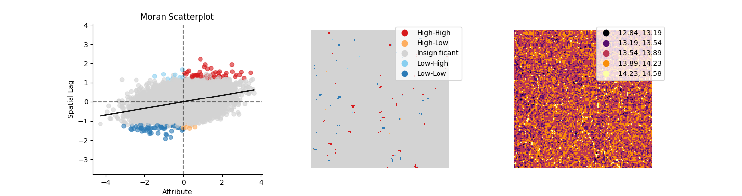
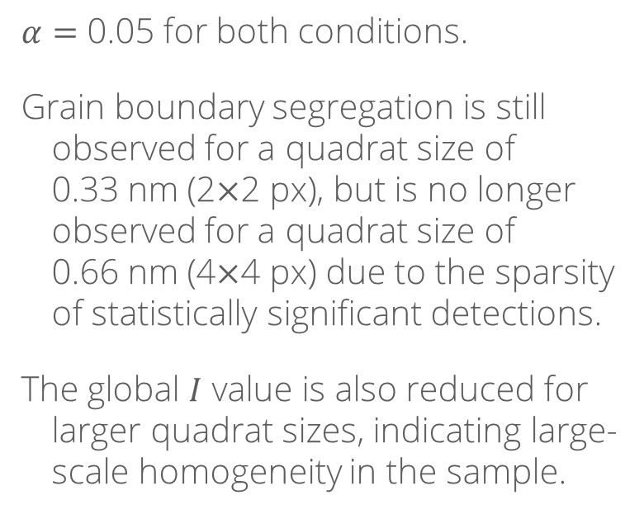
Moran’s $I$ for larger quadrats
0.33 nm
$α=$ 0.05 for both conditions.
Grain boundary segregation is still observed for a quadrat size of 0.33 nm (2$×$2 px), but is no longer observed for a quadrat size of 0.66 nm (4$×$4 px) due to the sparsity of statistically significant detections.
The global $I$ value is also reduced for larger quadrat sizes, indicating large-scale homogeneity in the sample.
0.66 nm

Slide 23
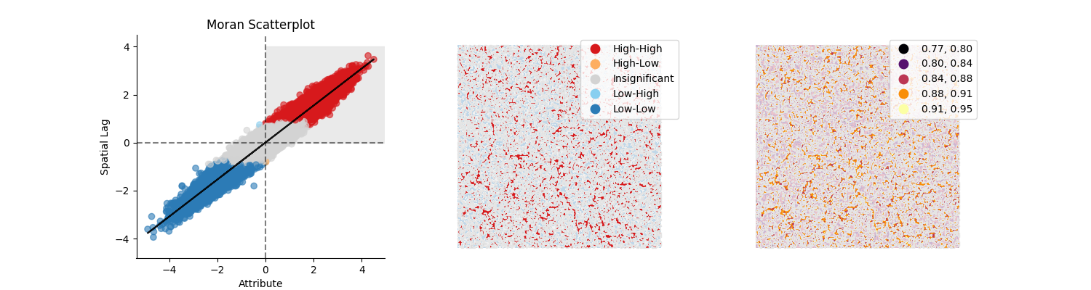
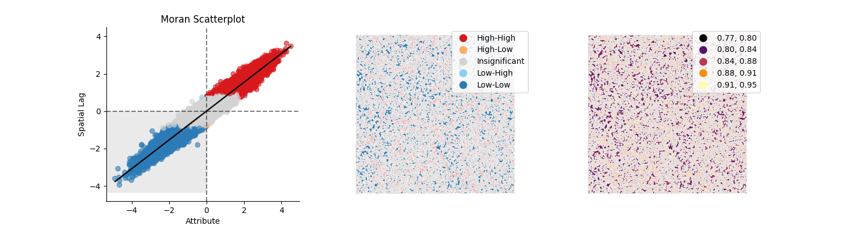
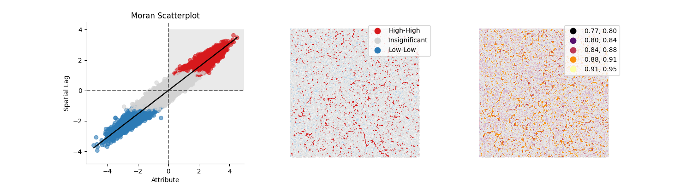
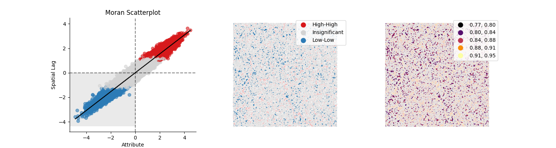


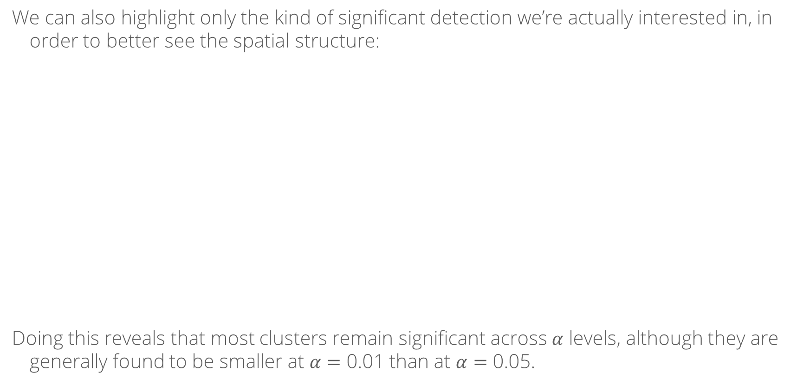


Highlighting by Moran quadrant
We can also highlight only the kind of significant detection we’re actually interested in, in order to better see the spatial structure:
Doing this reveals that most clusters remain significant across $α$ levels, although they are generally found to be smaller at $α=$ 0.01 than at $α=$ 0.05.
Quadrant 1 $α=$ 0.05
Quadrant 3 $α=$ 0.05
Quadrant 1 $α=$ 0.01
Quadrant 3 $α=$ 0.01

Slide 24

Conclusions (for this sample & region)
Some – but not all – grain boundaries are statistically significantly enriched in Au (deficient in Pt).
At the same level of significance, most of the grain interiors show many clusters of both types (Au enriched and Au deficient).
We may also want to use other approaches to identify which types of grain boundaries tend to show Au enrichment, but those techniques are beyond the scope of this tutorial.

Slide 25

Published examples from MSE & ChE
“Application of the quadrat counts method to the analysis of the spatial breakdown spots pattern in metal gate/MgO/InP structures,” Miranda, O’Connor & Hurley, Microelectronic Engineering 88(4), 2011, 10.1016/j.mee.2010.07.024
“Spatial statistics of pitting corrosion patterning: Quadrat counts and the non-homogeneous Poisson process,” López De La Cruz & Gutiérrez, Corrosion Science 50(5), 2008, 10.1016/j.corsci.2008.01.003
“Correlating local chemical and structural order using Geographic Information Systems-based spatial statistics,” Xu, Kumar & LeBeau, Ultramicroscopy 243, 2023, 10.1016/j.ultramic.2022.113642
“Characterisation of heterogeneity and spatial autocorrelation in phase separating mixtures using Moran’s $I$,” Thompson, Saveyn, Declercq, et al., Journal of Colloid and Interface Science 513, 2018, 10.1016/j.jcis.2017.10.115

Slide 26
Python code is available at:
https://github.com/realitychemist/data_analysis_scripts/blob/main/edxs_spatial.py

